Slide 1
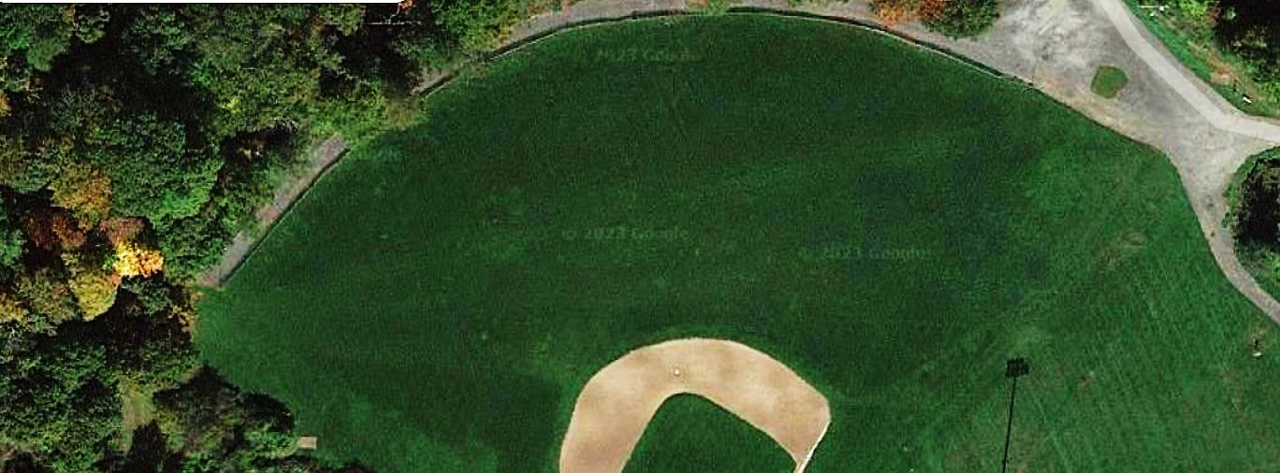
Lower Coakley
Monday 6:00-7:00 PM
LOWER B
LOWER A
Grade 4 Boys Hawks – Dave Siekman
Grade 4 Boys
Pioneers – Doug McInnis
LOWER C

Slide 2
Lower Coakley
Monday 7:00-8:00 PM
LOWER B
LOWER A
Grade 5-6 Boys
Mavericks – Ryan Russell
LOWER C

Slide 3
Lower Coakley
Monday 8:00-9:00 PM
LOWER B
LOWER A
LOWER C

Slide 4
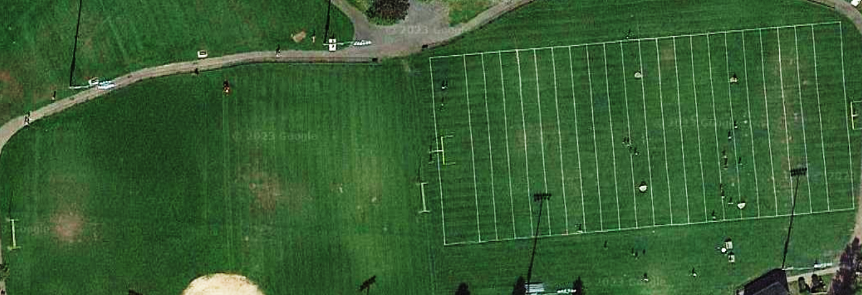
Upper Coakley
Monday 6:00-7:00 PM
Field 2 Grade 1/2 - Revs
Field 1
Grade 1/2 – Revs
Field 3 Grade 3 Boys - Revs
Grade 3 Girls – Team Night

Slide 5
Upper Coakley
Monday 7:00-8:00 PM
Field 1 – Revs Sign Ups
Dragons
Grade 7/8 Boys
Raiders – Mike Lockard
Field 2 – Revs Sign Ups
Grade 5/6 Boys
Wolfpack – Matt Kowalski
Grade 5/6 Girls
Thunder – Mark Hevert

Slide 6
Upper Coakley
Monday 8:00-9:00 PM
Grade 7/8 Boys Vikings – Dave Prickett
Grade 5/6 Boys Pirates – Patrick Hughes
Field 3
Field 4 Far
Field 4 Near

Slide 7
Lower Coakley
Wednesday 6:00-7:00
LOWER B
LOWER A
Grade 4 Boys Hawks – Dave Siekman
Grade 4 Boys
Pioneers – Doug McInnis
LOWER C
Grade 4 Boys Frontier – Ian Moorhouse

Slide 8
Lower Coakley
Wednesday 7:00-8:00 PM
LOWER B
LOWER A
Grade 7/8 Boys
Raiders – Mike Locklard
Grade 5-6 Boys
Mavericks – Ryan Russell
LOWER C

Slide 9
Lower Coakley
Wednesday 8:00-9:00 PM
LOWER B
LOWER A
LOWER C

Slide 10
Upper Coakley
Wednesday 6:00-7:00 PM
Field 2 Grade 1/2 - Revs
Field 1
Grade 1/2 - Revs
Field 3 Grade 3 Girls - Revs
Grade 3 Boys – Team Night

Slide 11
Upper Coakley
Monday 7:00-8:00 PM
Grade 4 Girls Clash – Mark Negron
Field 1 – Revs Sign Ups
Field 2 – Revs Sign Ups
Grade 5/6 Boys Wolfpack – Matt Kowalski
Grade 4 Girls Bolts – Ryan Bower
Grade 5/6 Girls Thunder – Mark Hevert

Slide 12
Upper Coakley
Wednesday 8:00-9:00 PM
Grade 7/8 Boys Vikings – Dave Prickett
Field 3
Field 1
Field 4

Slide 13
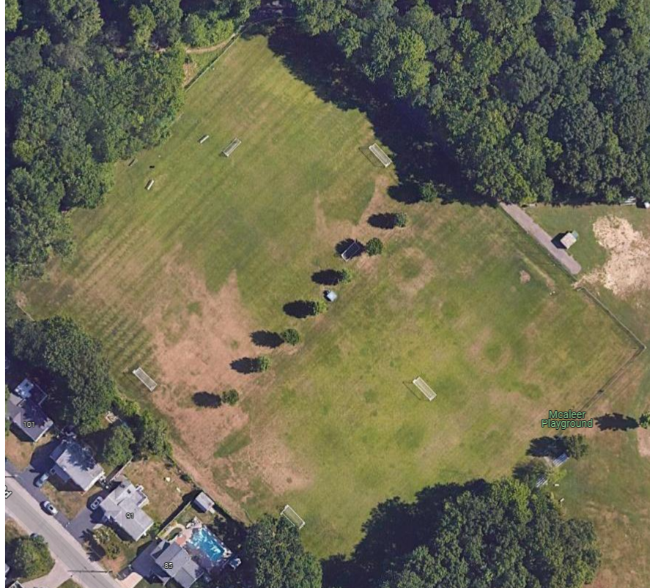
Father Macs
Monday 5:00-6:00 PM
Grade 5/6 Girls Wild – Tony Valeri

Slide 14
Father Macs
Monday 6:00-7:00 PM
Grade 5/6 Boys
Revolution – Susan Doughty
Grade 5/6 Girls
Mustangs – Laura Goldberg
Grade 7/8 Girls Lightning – Steve Weafer
Grade 7/8 Girls
Hurricanes – Pete Noble
Grade 7/8 Girls
Force – Vanessa McCarthy Boucher

Slide 15
Father Macs
Monday 7:00-8:00 PM

Slide 16
Father Macs
Tuesday 6:00-7:00 PM
Grade 7/8 Boys Warriors – Joe Papadopoulos
Grade 5/6 Boys Strikers – Mike Medeiros
Grade 5/6 Boys Blue Dynamo – Tim Doherty

Slide 17
Father Macs
Tuesday 7:00-8:00 PM
Grade 4 Girls Fierce – Kevin O’Rourke

Slide 18
Father Macs
Wednesday 5:00-6:00 PM
Grade 5/6 Girls
Wild – Tony Valeri
Grade 5/6 Boys
Revolution – Susan Doughty
Grade 5/6 Girls
Cyclones – Derek West

Slide 19
Father Macs
Wednesday 6:00-7:00 PM
Grade 5/6 Girls
Mustangs – Laura Goldberg
Grade HS Girls Mustangs – Matt Falherty
Grade 7/8 Girls Lightning – Steve Weafer
Grade 7/8 Girls Hurricanes – Pete Noble
Grade 7/8 Girls
Force – Vanessa McCarthy Boucher

Slide 20
Father Macs
Wednesday 7:00-8:00 PM
Grade HS Boys Stangs – Dave Carriero
Grade HS Boys Broncos – Camilo Ospina

Slide 21
Father Macs
Thursday 5:00-6:00 PM

Slide 22
Father Macs
Thursday 6:00-7:00 PM
Grade 7/8 Boys Warriors – Joe Papadopoulos
Grade 5/6 Boys Pirates – Patrick Hughes
Grade 5/6 Boys Minoans FC George Athanasiou
Grade 4 Boys Dragons – Clemens Alt
Grade 4 Girls Clash – Mark Negron
Grade 4 Girls Bolts – Ryan Bower

Slide 23
Father Macs
Thursday 7:00-8:00 PM
Grade 4 Girls Fierce – Kevin O’Rourke
Grade 5/6 Boys Strikers – Mike Medeiros

Slide 24
Father Macs
Friday 5:00-6:00 PM
Grade 5/6 Girls Cyclones – Derek West

Slide 25
Father Macs
Friday 6:00-7:00 PM
Grade 4 Boys Frontier – Ian Moorhouse

Slide 26
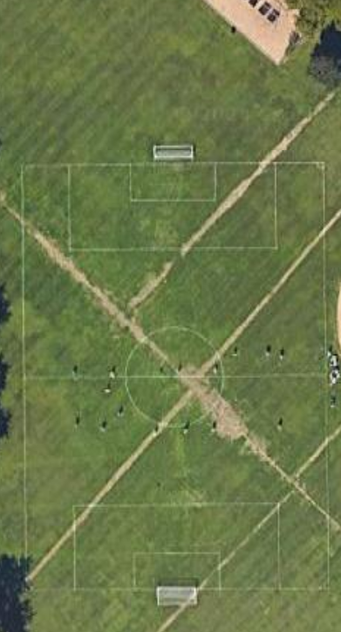
Ellis Field
Wednesday 5:00-6:00 PM

Slide 27
Ellis Field
Wednesday 6:00-7:00 PM
Grade 5/6 Boys Minoans FC – George Athanasiou
Grade 5/6 Boys Blue Dynamo – Tim Doherty

Slide 28
Ellis Field
Wednesday 7:00-8:00 PM

